Slide 1
ShanghaiTech University
EE 115B: Digital Circuits
Fall 2024
Lecture 12
Hengzhao Yang
November 19, 2024

Slide 2
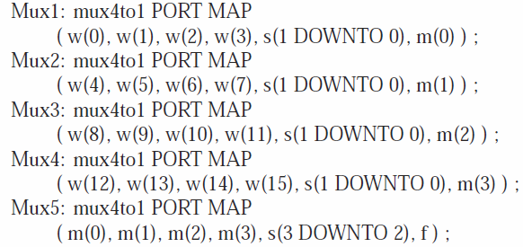
FOR GENERATE statement
A compact form to instantiate components
Example: 16-to-1 mux
Original code

Slide 3
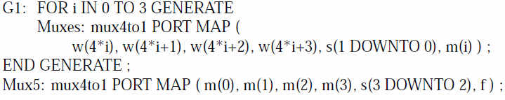
FOR GENERATE statement
Code using FOR GENERATE statement
  “G1” is a label for this statement
  “i” is a local variable whose scope is limited to this statement

Slide 4
PROCESS
Architecture
  PROCESS statements
    IF statements
    CASE statements

Slide 5
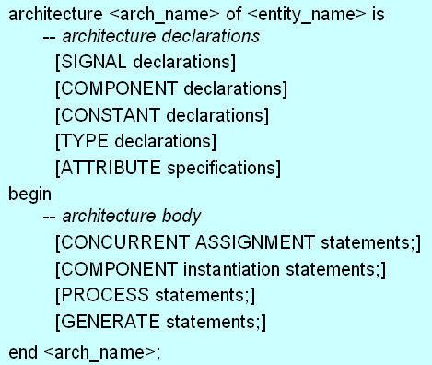
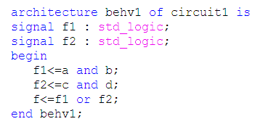
Architecture: general form
CONCURRENT ASSIGNMENT statements
SIGNAL declarations

Slide 6
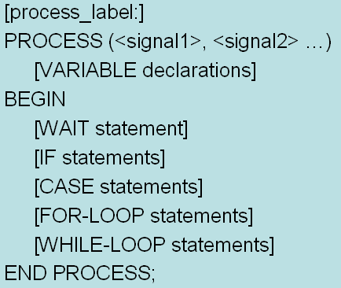
PROCESS
Multiple PROCESS statements are concurrent
Statements inside a PROCESS are sequential
Syntax

Slide 7
PROCESS
Optional: process_label
Sensitivity list: (<signal 1>, <signal 2> …)
  Specify signals that cause the PROCESS to be evaluated
  When the value of any signal in the sensitivity list changes, the PROCESS is active and the statements inside the PROCESS are executed in sequential order
  Statements inside PROCESS: IF, CASE, WAIT, LOOP

Slide 8
PROCESS
Any assignments made to signals inside the PROCESS are not visible outside the PROCESS until all the statements in the PROCESS have been evaluated.
Signal assignments only take effect at the end of the PROCESS.
If multiple assignments are made to the same signal, only the last one has any visible effect.

Slide 9
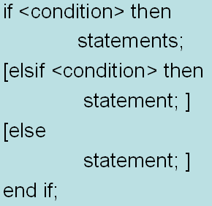
IF statement
IF statement can only appear in a PROCESS
Syntax

Slide 10
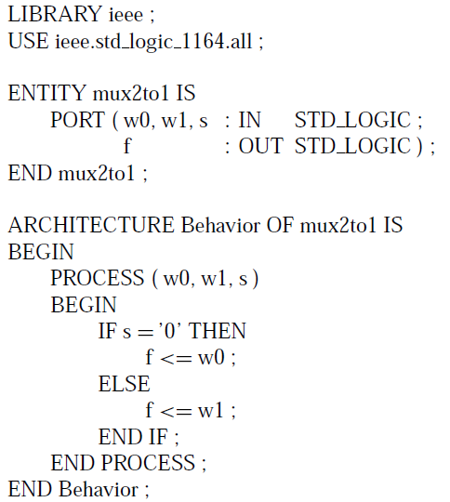
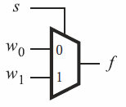
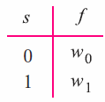
Example: 2-to-1 mux
Style 1

Slide 11
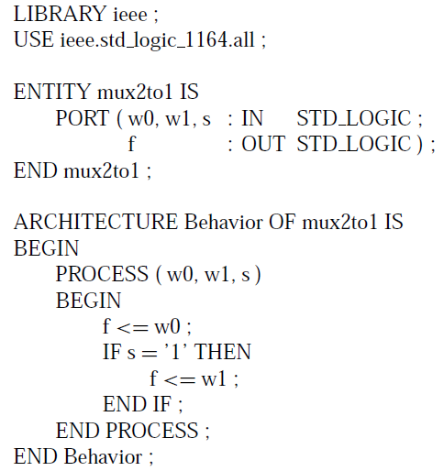
Example: 2-to-1 mux
Style 2
Default assignment
  f<=w0;
  This assignment is scheduled to occur after all statements in the PROCESS have been evaluated
  Default value may be overridden

Slide 12
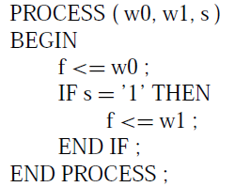

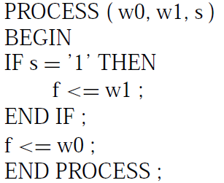
Sequential statements
Ordering of statements in a PROCESS can affect the meaning of the code
Order 1
  Circuit: 2-to-1 mux
  Function:
Order 2
  Function:

Slide 13
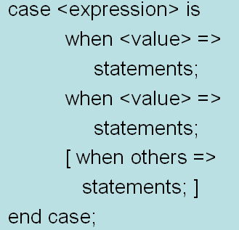
CASE statement
CASE statement can only appear in a PROCESS
Syntax

Slide 14
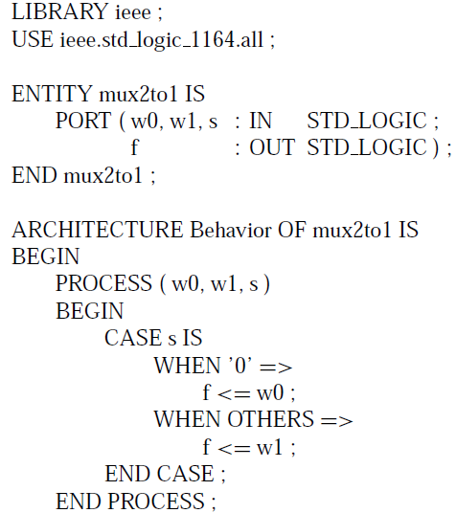
Example: 2-to-1 mux

Slide 15
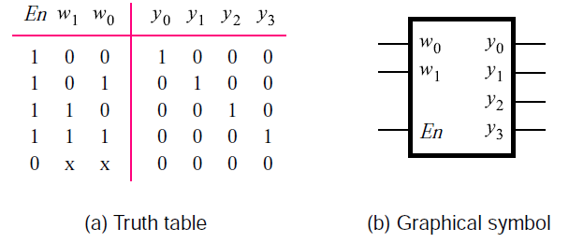
Example: 2-to-4 binary decoder
Truth table

Slide 16
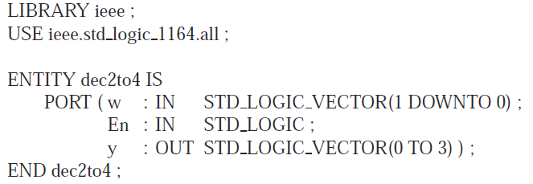
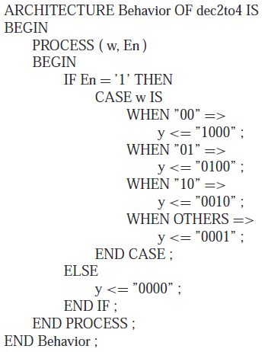
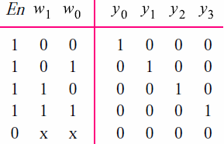
Example: 2-to-4 binary decoder

Slide 17
Chapter 7 Basic Sequential Circuits
Latches
Flip-Flops
Registers
Counters

Slide 18
Logic circuits
Combinational circuits
  Outputs only depend on present inputs
  Examples: muxes, demuxes, encoders, decoders, comparators, and adders
Sequential circuits
  Outputs depend on present inputs AND past behavior of the circuit
  Examples: latches, flip-flops, registers, and counters

Slide 19
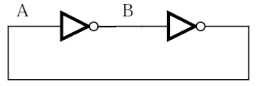
A memory element
Storage/memory elements are circuits that store the values of logic signals.
Two cascaded inverters
Two possible states
  A=0, B=1
  A=1, B=0
Not useful: states cannot be changed

Slide 20
Latches
A latch is a circuit that can store one bit of information.
Latches
  Basic SR latch
  Gated SR latch
  Gated D latch

